Slide 1


CROWDFUNDING KICKSTARTER PROJECT
Kickstarter is a funded company based in Brooklyn (United States), founded in 2009 by Yancey Strickler, Perry Chen and Charles Adler.
It enables individuals and organizations to raise funds for creative projects—such as technology, art, film, games, design, and music—without relying on traditional investors or loans.
“Understanding How Kickstarter Crowdfunding Works”
Creators launch:
A campaign by building a project page that outlines the funding goal, timeline, project description, and reward tiers for backers.
Backers Pledge Money :
Backers support the project by pledging money and selecting a reward tie.
All-or-Nothing Funding:
If the funding goal is met or exceeded, the creator receives the money. If the goal is not reached, no funds are collected, and backers are not charged.
Creator deliver Rewards:
Once the project is funded, creators complete the project and fulfill the promised rewards to backers

Slide 2




Project Creators – Group 5
Isha Peter
Simran Kumari
Geetika Sai
Sowmya Shevire
Chaitanya Tamatam

Slide 3


Project Objective
Analyze crowdfunding campaigns’ performance.
Identify trends, successes, and areas of improvement.
Utilize multiple tools for insights: Excel, Power BI, Tableau, SQL.
Visual: Simple Dashboard representing each tool.

Slide 4




Methodology
Data Cleaning : Excel/SQL.
Analysis & Visualization: Power BI & Tableau.
Key Metrics: Success rate, pledged amount vs goal, average funding per category, top-performing campaigns.
Visual: Flowchart of data → analysis → visualization.

Slide 5
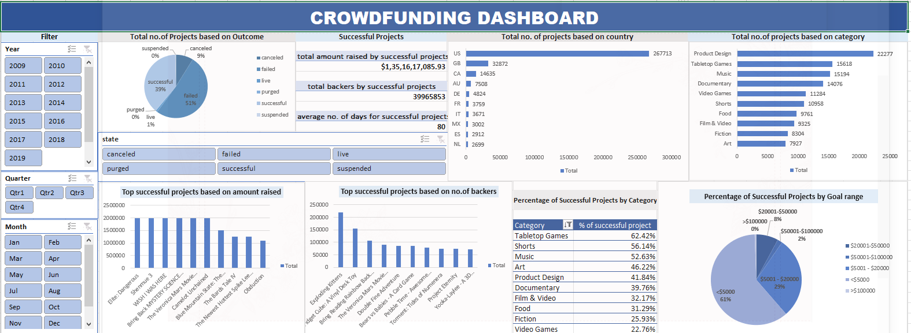
Excel Analysis
Initial data exploration.
Pivot tables for summary status: total campaigns, success rate, average funding.
Example insight: Total no. of Projects based on Outcome.
Visual: Chart Visualization.

Slide 6
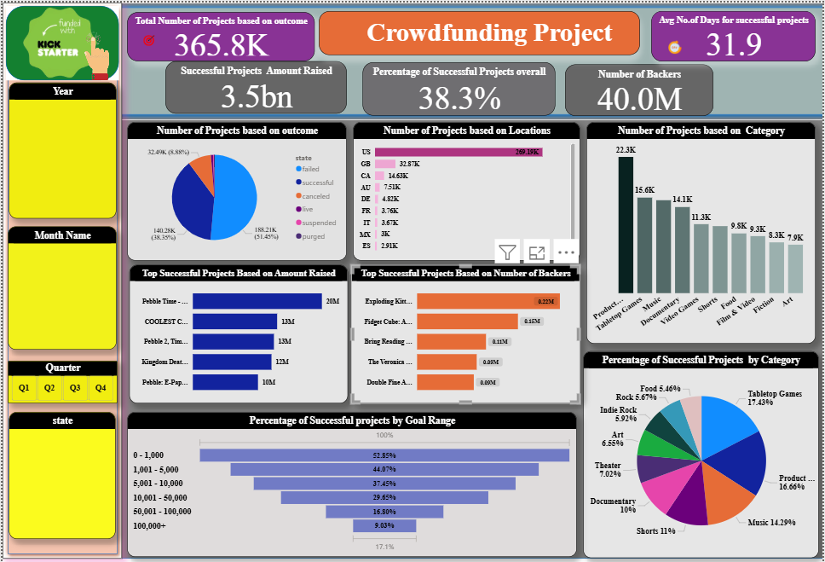
Power BI Insights
Interactive dashboards for KPIs.
Detailed Analysis by Category, Country, Funding stage.
Visual: Screenshot of dashboard.

Slide 7
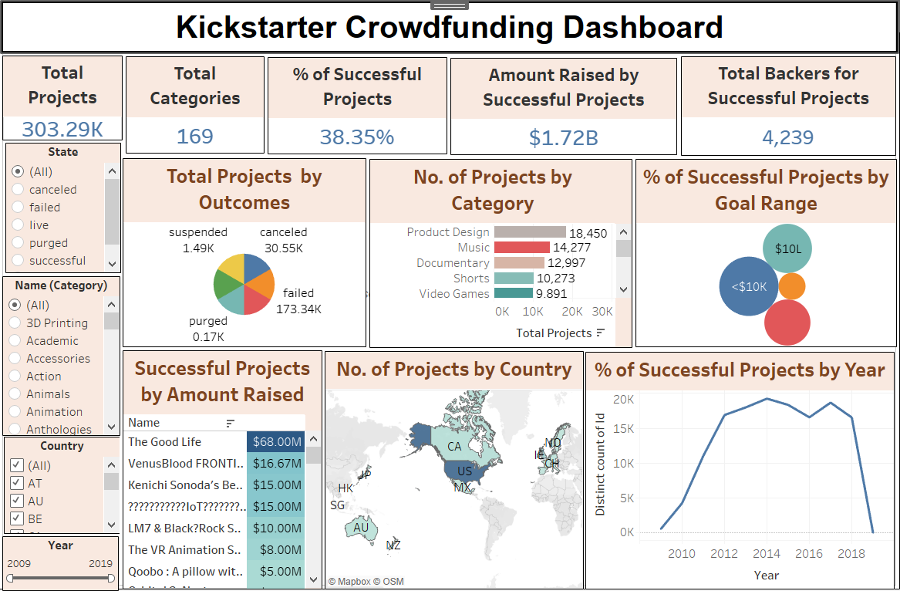
Tableau Insights
Advanced visualizations for trends.
Example insights:
  Campaign duration vs success rate. ( by using Slicers).
Visual: Screenshot of Tableau Dashboard
1
2
3
6

Slide 8
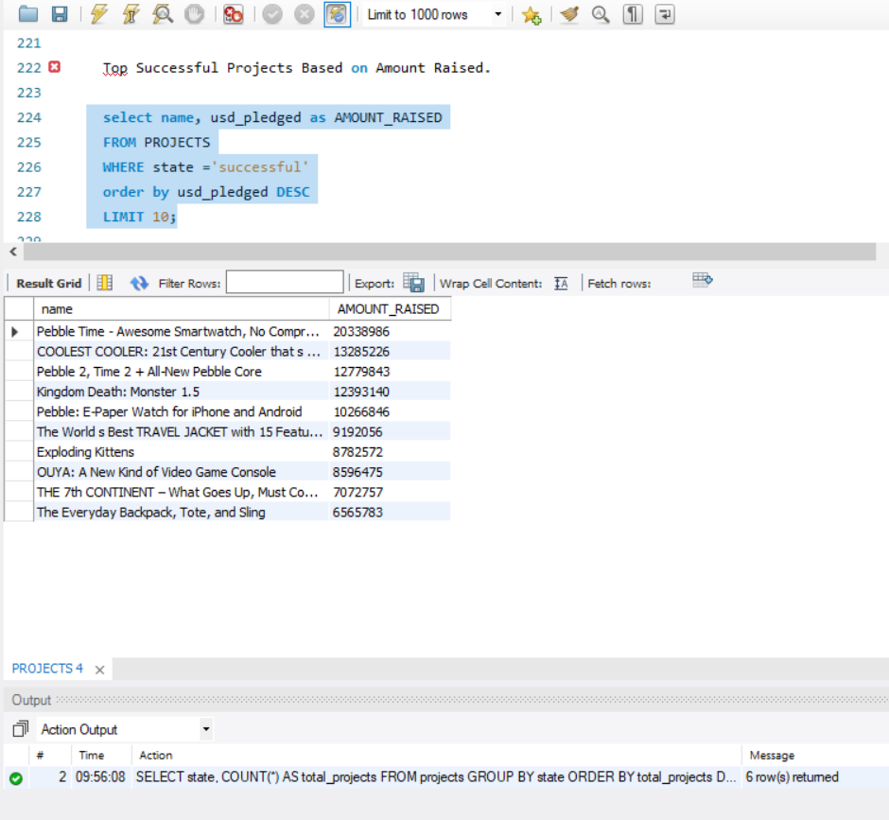
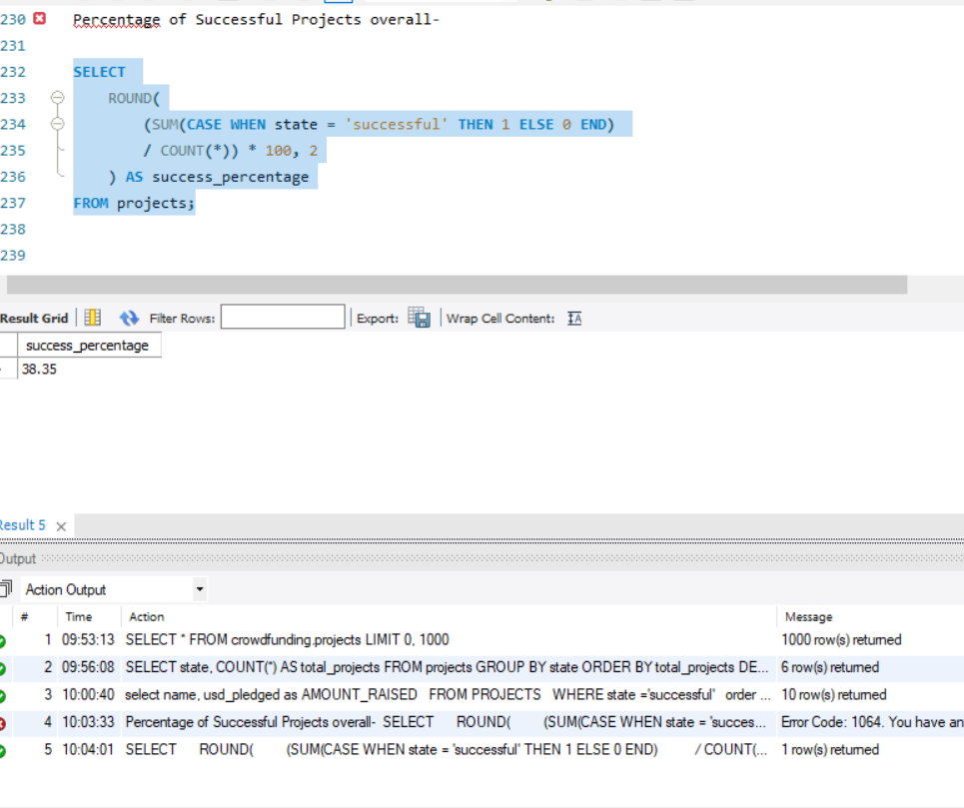
SQL Analysis
1
2
3
Querying for filtered insights: e.g., % of Successful Projects Overall & Top Successful Projects based on Amount.
Visual: SQL query snippet + small table of results
6

Slide 9

Conclusion
This analysis of Kickstarter project data, using tools like Excel, SQL, Power BI, and Tableau, offers a detailed understanding of the key factors that influence project success.
SQL was used for data preparation and querying, while Excel supported detailed cleaning and initial statistical analysis. Power BI and Tableau added further value by providing interactive visualizations and dashboards that highlighted key trends, including funding performance, category-level success rates, and backer engagement.
The study showed that projects with moderate funding goals, shorter campaign durations, and compelling descriptions are more likely to succeed.
Overall, the project showed that data-driven decision-making can improve crowdfunding outcomes and highlighted Kickstarter’s role in supporting innovation, creativity, and community through a transparent and accessible funding platform.

Slide 10


Presentation by the Group -5

